Slide 1
End-to-End Training of Deep Visuomotor Policies
Sergey Leviney svlevine@eecs.berkeley.edu
Chelsea Finny cbfinn@eecs.berkeley.edu
Trevor Darrell trevor@eecs.berkeley.edu
Pieter Abbeel pabbeel@eecs.berkeley.edu
Division of Computer Science University of California Berkeley, CA 94720-1776, USA

Slide 2
The related works of Sergey Leviney :
S. Levine and V. Koltun. Guided policy search. In International Conference on Machine Learning (ICML), 2013a.
S. Levine and V. Koltun. Variational policy search via trajectory optimization. In Advances in Neural Information Processing Systems (NIPS), 2013b.
3. S. Levine and V. Koltun. Learning complex neural network policies with trajectory
optimization. In International Conference on Machine Learning (ICML), 2014.
S. Levine and P. Abbeel. Learning neural network policies with guided policy search under unknown dynamics. In Advances in Neural Information Processing Systems (NIPS), 2014.
S. Levine, N. Wagener, and P. Abbeel. Learning contact-rich manipulation skills
with guided policy search. In International Conference on Robotics and
Automation (ICRA), 2015.

Slide 3
The related works by Sergey Leviney :
Paper 1: this paper that introduced the Guided policy search (GPS) alogrithm.The policy search is
model-free, it is guided by a model-based DDP alogrithm, which generate the guided
samples, and use importance sampling to incorporate the guiding samples.
(ISGPS)
Paper 2: this paper introduced the Variational Guided Policy Search alogrithm based on trajectory
optimization.(VGPS)
Paper 3: this paper introduced the Constrained guided policy search alogrithm based on trajectory
optimization.(CGPS)
Paper 4: this paper introduced a method to fit the system dynamics with the trajectory’s samples, so that
in the GPS alogrithm, the guided alogrithm can work model-free.
Paper 5: the alogrithm above are all execute simulated robotic manipulation tasks. This paper introduced
several improvements to the guided policy search alogrithm in paper 4 to make it more practical
for robotic applications, and successfully run on a real robot.

Slide 4
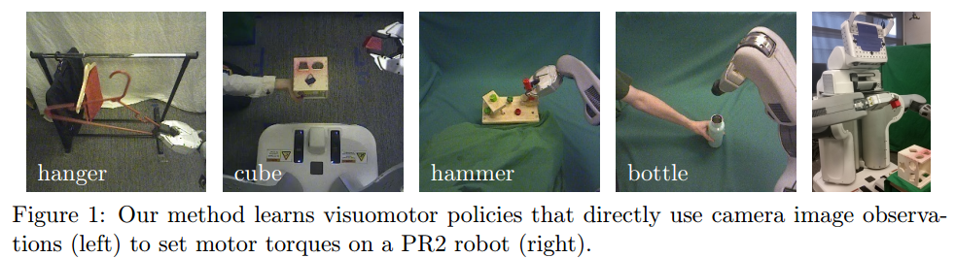
END TO END : using deep neural networks to map image pixels and joint angles to motor torques
The paper’s contribution:
Developing a guided policy search algorithm for sensorimotor deep learning
Developing a novel CNN architecture designed for robotic control
Robot control: 20Hz, images: 240x240, robot joint torques: 7 DoF arm

Slide 5
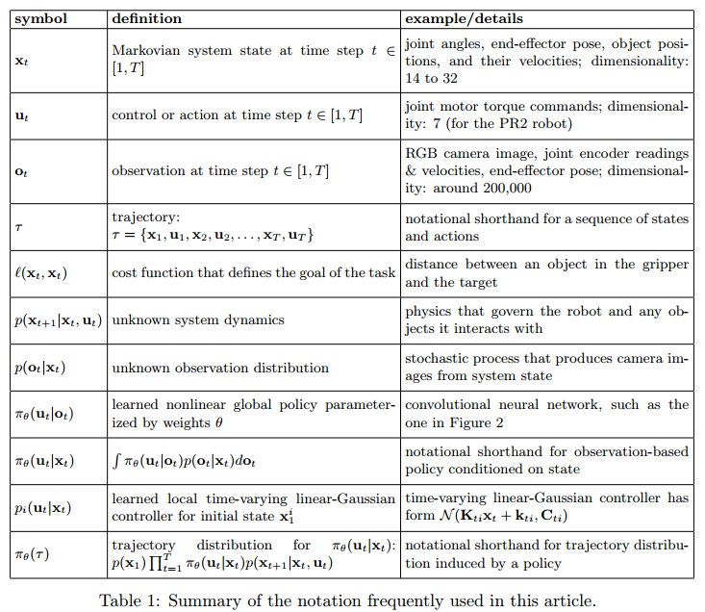

Slide 6
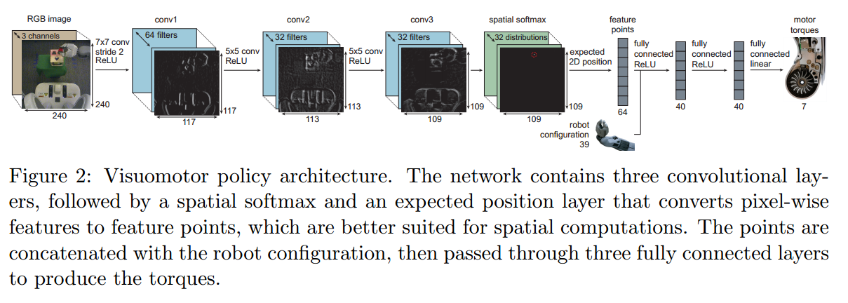
Policy architecture: πθ(ut|ot)
The network has 7 layers and around 92000 parameters, of which 86,000 are in the convolutional layers

Slide 7

spatial softmax and an expected position layer in policy network:
acij = max(0, zcij) for each channel c and each pixel coordinate (i; j)
where (xij, yij) is the image-space position of the point (i, j) in the response map
The effect of the layer:
serve to convert pixel-wise representations in the convolutional layers to spatial coordinate representations, which can be manipulated by the fully connected layers into 3D positions or motor torques
provides lateral inhibition, which suppresses low, erroneous activations, only keeping strong activations that are more likely to be accurate. This makes the policy more robust to distractors, providing generalization to novel visual variation.

Slide 8

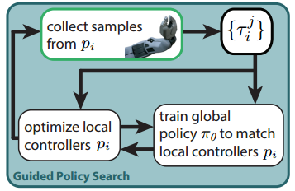
Guided policy search algorithm:
The GPS algorithm separates the problem into separate phases:
1. Supervised learning phases
2. Trajectory learning phases
i: different initial state
Pi: pi(ut | xt), the guiding trajectory distributions
πθ: πθ(ut | ot), the deep visuomotor policie
In supervised learning phases:
use the trajectories generated by all Pi to training
the global policy πθ to fit the guiding distributions Pi
In trajectory learning phases:
pi(ut | xt) is learned local learned local time-
varying linear-Gaussian controller for initial state xi ,
it is optimized with a variant of the iterative linear-
quadratic-Gaussian regulator (iLQG), which is a
variant of DDP (Differential dynamic programming)

Slide 9
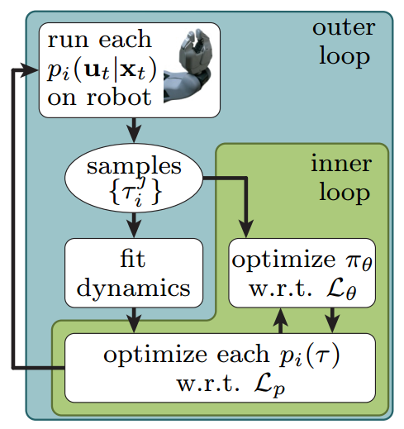
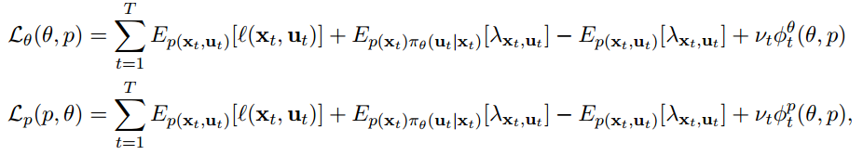
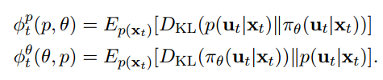
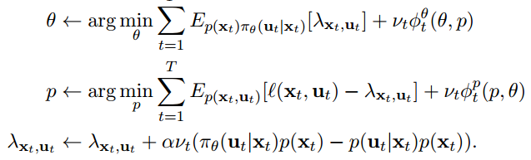
Guided policy search algorithm optimization:
When training, the guiding distributions Pi need the state xt and the system dynamics p(xt+1|xt, ut) since the DDP is a model-based method, but the GPS method is model-free, so the algorithm use the trajectories to fit the system dynamics while training the policy:
The object is a constrained problem :

Slide 10
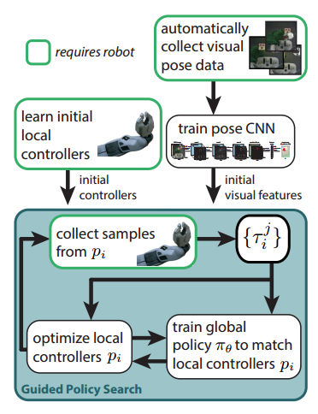
Pre-training: introduce a pretraining scheme that allows to train effective policies with a relatively small number of iterations
1. Initial visual features:
pretrain the convolutional layers of our network by
predicting elements of xt that are not provided in the
observation ot, such as the positions of objects in the
scene.
initialize the first layer filters from the model of
Szegedy et al. (2014), which is trained on ImageNet
(Deng et al., 2009) classification.
2. Initial controllers
initially train the guiding trajectory distributions
pi(ut|xt) independently of the convolutional network
until the trajectories achieve a basic level of
competence at the task, and then switch to full guided
policy search with end-to-end training of πθ(ut|ot)

Slide 11
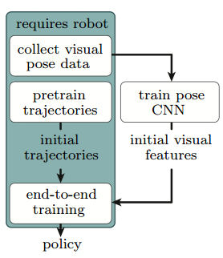
The whole alogrithm:
supplementary video: http://sites.google.com/site/visuomotorpolicy

Slide 12
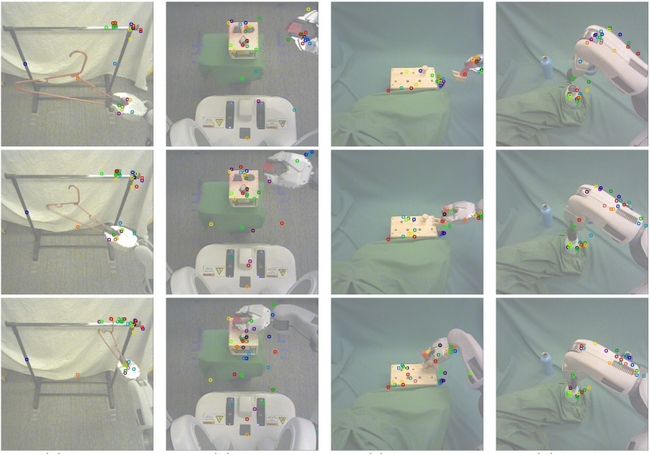
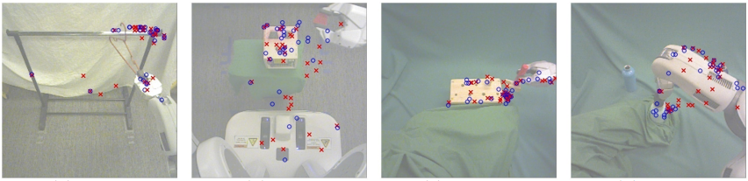
Feature points tracked by the policy during task execution for each of the four tasks. Each feature point is displayed in a different random color, with consistent coloring across images. The policy finds features on the target object and the robot gripper and arm. In the bottle cap task, note that the policy correctly ignores the distractor bottle in the background, even though it was not present during training
Feature points learned for each task. For each input image, the feature points produced by the policy are shown in blue, while the feature points of the pose prediction network are shown in red. The end-to-end trained policy tends to discover more feature points on the target object and the robot arm than the pose prediction network.

Slide 13
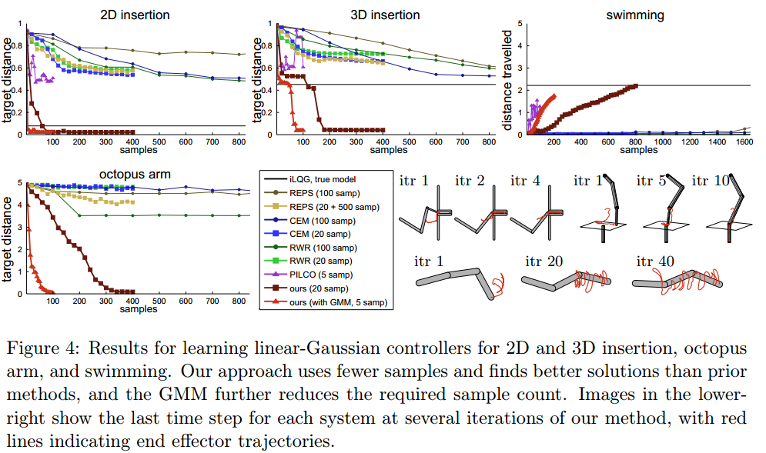

Slide 14
